Slide 1

Introduction to
sequence analysis
Luca Badolato*
Summer Incubator Workshops Series 2022
Max Planck Institute for Demographic Research
July 26, Rostock
*Department of Sociology and
Institute for Population Research, The Ohio State University

Slide 2

Intro to Sequence Analysis. Goals of the workshop:
Provide an introduction to Sequence Analysis:
Purposes of Sequence Analysis, object of analysis, methodological and historical developments across the years
Getting familiar with the basic measures and methods
Visualizing sequences and computing sequence indicators
Show an application of Sequence Analysis in R using the package TraMineR
2

Slide 3
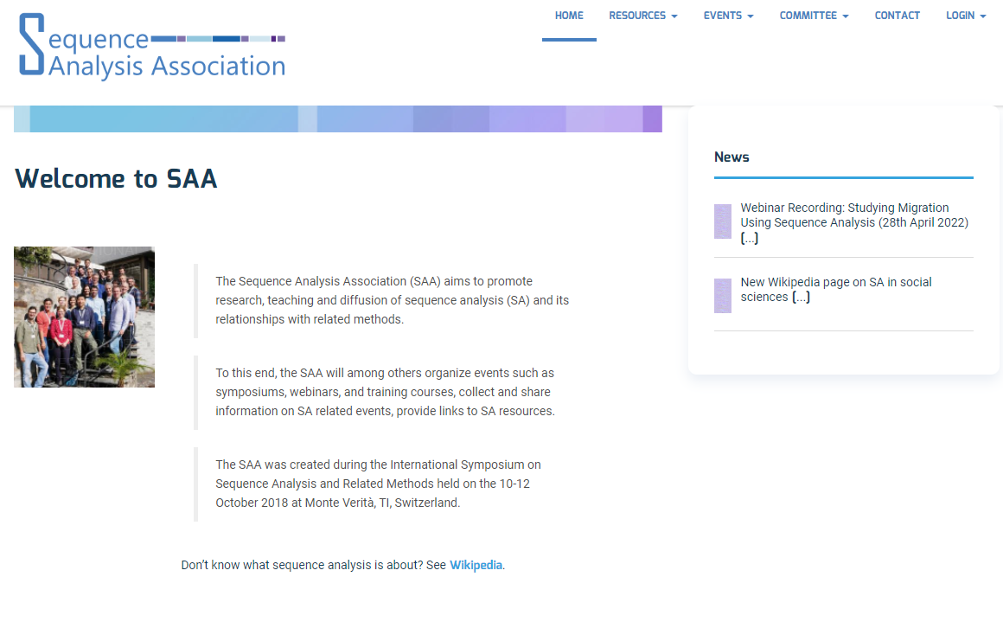
Sequence Analysis, where to find information
3

Slide 4
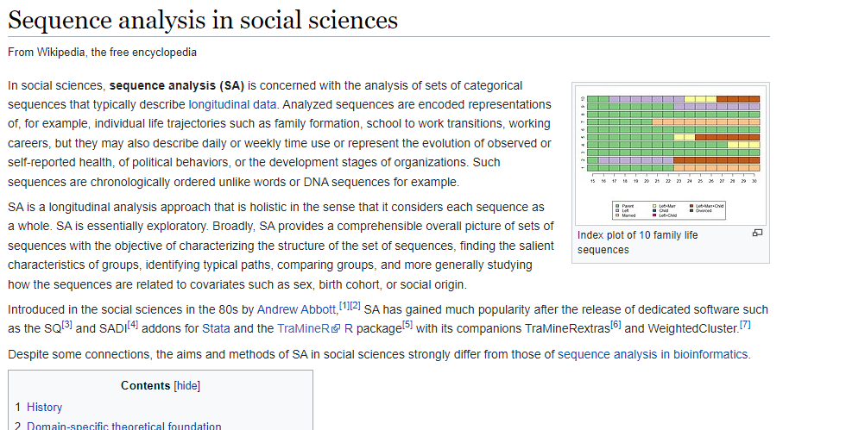
Sequence Analysis, where to find information
4

Slide 5
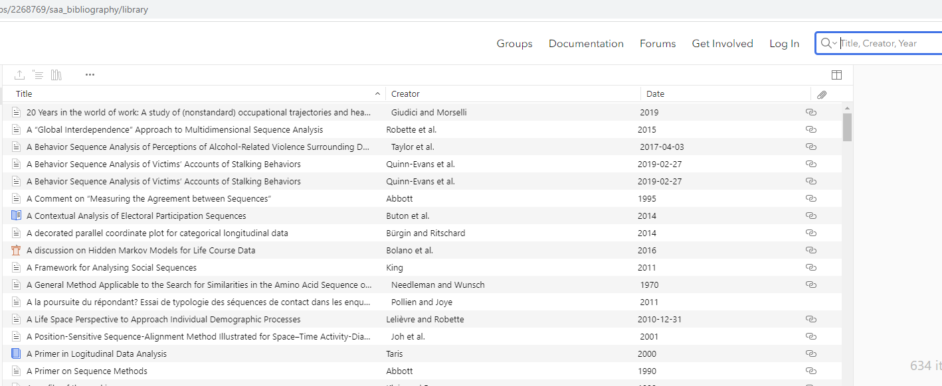
Sequence Analysis, where to find information
5

Slide 6

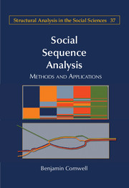


Sequence Analysis, where to find information
(2014)
(2015)
(2018)
(2022)
6

Slide 7
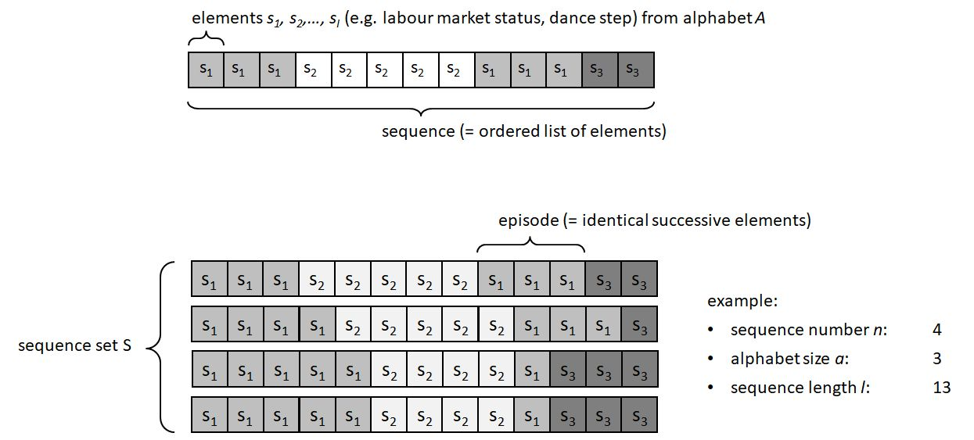
Sequence Analysis: Object of analysis
The object of analysis is a set of sequences, ordered lists of elements (s1, s2, …, sl) taken from a finite alphabet (state space) A.
Two requirements:
The elements of a sequence have to be ordered according to certain criteria (as we will see, in social sciences and demography usually a time dimension, such as age)
The elements (s1, s2, …, sl) take value from a finite set A, called “alphabet” (e.g., in the case of labor market status, the elements could be “employed” and “unemployed”).
7

Slide 8
Sequence Analysis: Object of analysis
A set of sequences n constitutes the object of analysis, our data frame. A few basic elements:
n : number of sequences in the data frame
a = |A| : size of the alphabet
l : length of each sequence (It is possible to include sequences of different length)
Transition : succession from a state i to a state j
Source: https://en.wikipedia.org/wiki/Sequence_analysis_in_social_sciences
8

Slide 9
Sequence Analysis: Object of analysis
Sequence Analysis is the systematic and statistical analysis of a set of sequences. Traditionally, two main purposes:
Analysis of the sequences, computing indicators of individual sequences (e.g. number of transitions, diversity, complexity)
Dissimilarity-based analysis: cluster analysis (Optimal Matching)
Source: https://en.wikipedia.org/wiki/Sequence_analysis_in_social_sciences
9

Slide 10
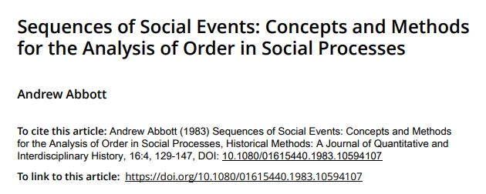
From where? A historical overview
Sequence Analysis was introduced in the social sciences in the 1980s by Abbott, professor of sociology at the University of Chicago, from the biological sciences, where was developed to analyze DNA sequences, and information theory.
“How can we generalize about sequences of social events? In the past, such sequences have generally been the territory of historians. Yet, historians are little given to generalization. It is the sociologists who generalize, and they have said little about sequences. This paper aims to bridge the gap.” (Abbott 1983, p. 129)
10

Slide 11
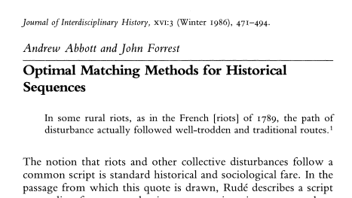
From where? A historical overview
Introduction of Optimal Matching, which has become the most well-known method to compute distances between sequences in a clustering framework, as we will discuss later.
11

Slide 12
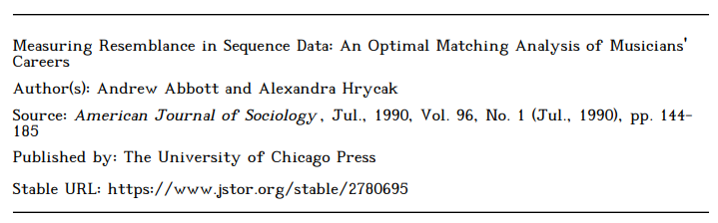
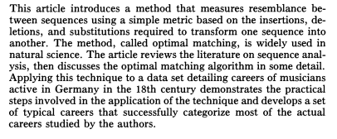
From where? A historical overview
In 1990, a seminal paper in AJS to introduce Optimal Matching in sociology:
12

Slide 13
From where? A historical overview
Abbott and Hrycak (1990)
Analysis of careers and resemblance among career patterns:
Central in sociology: social mobility, organizational structure
Idea of analyzing careers as sequences: (i) individuals plan and structure their work histories, (ii) future career is not only influenced by the immediate present but also the actual sequence of experience in the past, and (iii) necessity to analyze work trajectories holistically
Are there common patterns of career trajectories? How are they produced?
13

Slide 14
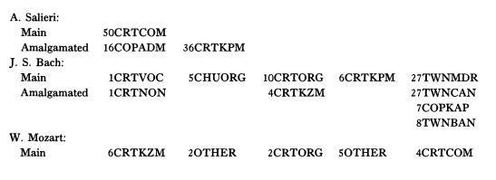
From where? A historical overview
Analysis of the careers of 595 musicians active in Germany during the Baroque and Classical eras, around 1660 – 1800.
Interesting description of the job system for musicians in 18th century Germany, a complex and unstable market stratified among towns and courts, where music was shaped largely by the local princes. Which career trajectories followed the major administrators (kapellmeisters and others) in town and courts?
CRTCOM: Court Composer
CRTVOC: Court Vocalist
CHUORG: Church organist
CRTORG: Court organist
CRTKPM: Court kapellmeister
TWNMDR: Town music director
Example: A successful career in court composition (Salieri), a variegated career leading to a prominent town position (Bach), and a short and relatively “unsuccessful” court career (Mozart).
14

Slide 15
From where? A historical overview
Still, we have to keep in mind that the scientific process is not linear. Longstanding tradition and foundations in sociological theories on regularities and sequencing of social phenomena.
For example:
Durkheim: Norms and regularity of actions
Giddens: Theory of structuration (social actors interface with each other in structured and sequenced patterns and routines)
Bourdieu: Habitus, stable worldviews in guiding everyday action and producing predictable, orderly sequences of behavior.
15

Slide 16
From Salieri and Mozart to 3 decades of flourishing applications
Sociology
Labor market
Residential trajectories
Time use
Life course
Demography
Transition to adulthood
Partnership biographies
Family formation
Childbirth histories
Medicine
Trajectories of chronic diseases
Political Sciences
Pathways towards democratization
Legislative processes
National crises and revolutions
Geography
Mobility studies
Land use
Psychology
Learning and interactions between individuals
16

Slide 17
Flourishing of Sequence Analysis, why?
Two primary reasons:
Development of statistical software and data collection that made Sequence Analysis easy and feasible
Longitudinal and cross-sectional surveys that collected detailed individual-level data on careers, marital history, time use and time diary records.
Development of time-series data of larger social units, including organizations, neighborhoods, cities, and nations (e.g. World Values Survey, International Social Survey Programme)
Dedicated software: optimize, tda, SQ and SADI for Stata, TraMineR for R
17

Slide 18
Expansion of Sequence Analysis, why?
Theoretical developments in sociology: the life course perspective.
Interdisciplinary program of study has been under development since the mid-1970s
Giele and Elder (1998) -> Four key elements: (i) Location in time and space (history and culture), (ii) Human agency (development of the individual), (iii) Linked lives (social relations), (iv) Timing (Intersection of age, period, and cohort)
Life course analysis as the statistical analysis of data on the timing of events (when do events happen?), their sequencing (in which order do events happen?), and their quantum (how many events happen?) (Billari 2002)
18

Slide 19
Expansion of Sequence Analysis, why?
Theoretical developments in sociology: the life course perspective.
Life trajectories as the main object of analysis: family dynamics, transition to adulthood, and aging
Need for a holistic approach for life course analysis -> Sequence Analysis:
Life courses as subject to accurate inter-temporal planning (internal calendars)
Life courses as a holistic conceptual unit, contingent results of subsequent events.
Need for an algorithmic approach to describe and analyze the timing, sequencing, and quantum of life course events
19

Slide 20
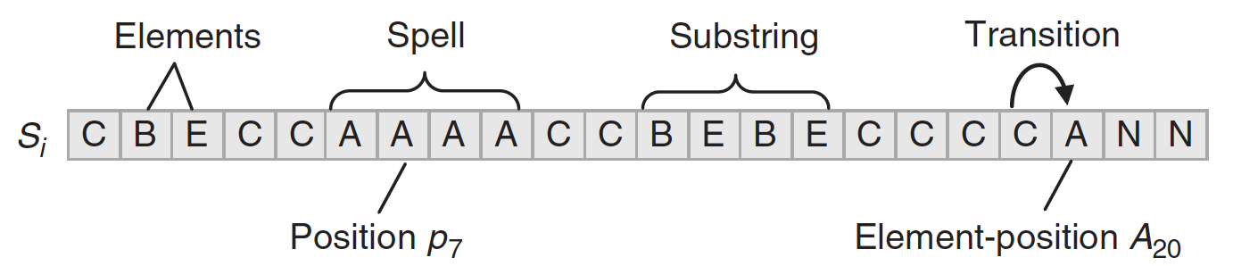
Formalizing the method: Basic concepts
The object of analysis is a set of sequences, ordered lists of elements (s1, s2, …, sl) taken from a finite alphabet (state space) A.
Position: a key issue in sequence analysis is where and in what order elements appear in a sequence. Elements are ordered with respect to specific criteria, which can be e.g. temporal, spatial, hierarchical. Elements occupy a specific position.
Subsequence: A set of ordered elements of a sequence, which need not be adjacent to each other in the parent sequence but have to appear in the same order. Example: CEAACCN.
20

Slide 21
Formalizing the method: Basic concepts
Substring: A subsequence that is composed of only consecutive elements.
Spells: A set of contiguous positions that all contain the same element. Spells are useful to report in a concise format a long sequence. For example, the sequence AAAACCNNNNB, can be reported as (A,4)-(C,2)-(N,4)-(B,1) (state-permanence-sequence format).
21

Slide 22
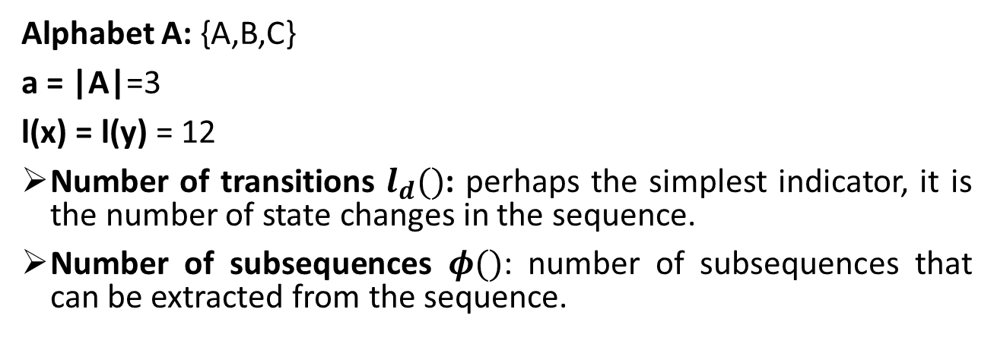
Describing the sequences: indicators
A
A
A
A
B
B
C
A
C
A
A
A
Sequence x
A
A
A
A
A
A
B
B
B
B
B
B
Sequence y
Alphabet A: {A,B,C}
a = |A|=3
l(x) = l(y) = 12
Number of transitions $l_{d}()$: perhaps the simplest indicator, it is the number of state changes in the sequence.
Number of subsequences $φ()$: number of subsequences that can be extracted from the sequence.
22

Slide 23
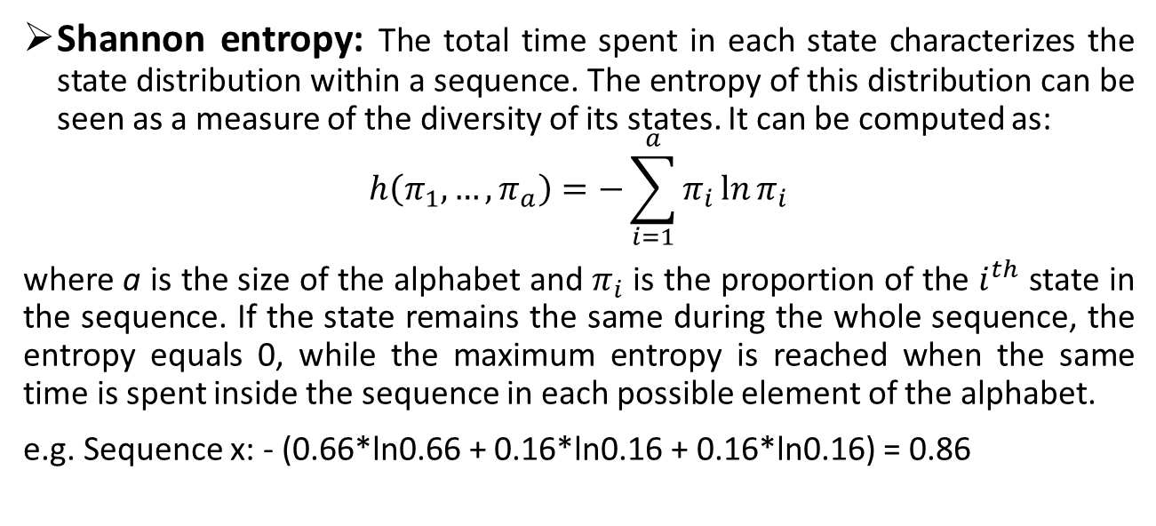
Describing the sequences: indicators
A
A
A
A
B
B
C
A
C
A
A
A
Sequence x
A
A
A
A
A
A
B
B
B
B
B
B
Sequence y
Shannon entropy: The total time spent in each state characterizes the state distribution within a sequence. The entropy of this distribution can be seen as a measure of the diversity of its states. It can be computed as:
$$h\left(π_{1}, …, π_{a}\right)=−\sum_{i=1}^{a}{π_{i}\ln{π_{i}}}$$
where a is the size of the alphabet and $π_{i}$ is the proportion of the $i^{th}$ state in the sequence. If the state remains the same during the whole sequence, the entropy equals 0, while the maximum entropy is reached when the same time is spent inside the sequence in each possible element of the alphabet.
e.g. Sequence x: - (0.66*ln0.66 + 0.16*ln0.16 + 0.16*ln0.16) = 0.86
23

Slide 24
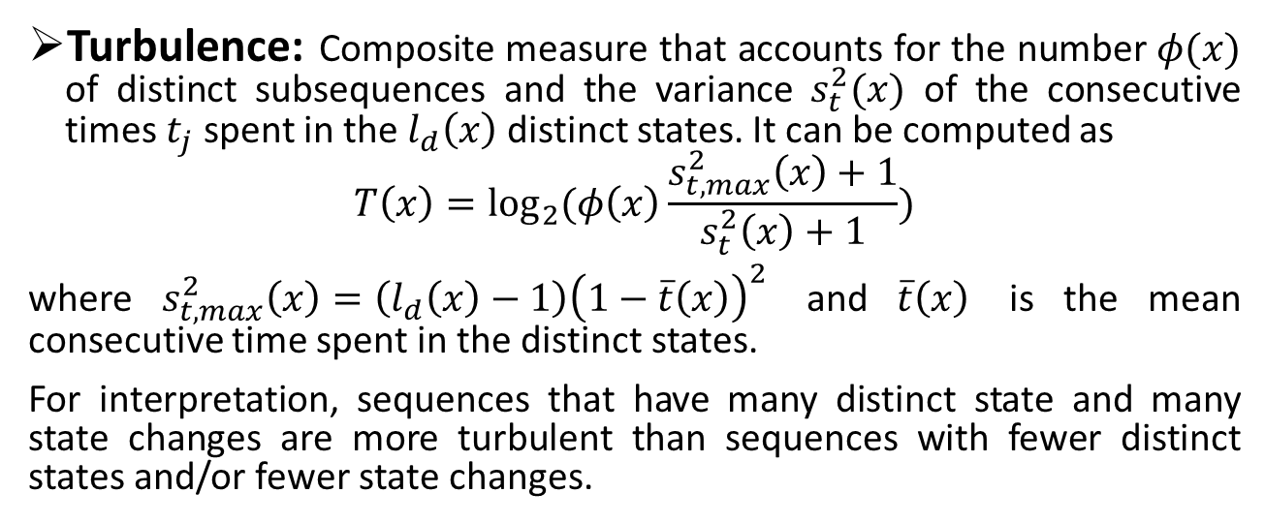
Describing the sequences: indicators
A
A
A
A
B
B
C
A
C
A
A
A
Sequence x
A
A
A
A
A
A
B
B
B
B
B
B
Sequence y
Turbulence: Composite measure that accounts for the number $φ(x)$ of distinct subsequences and the variance $s_{t}^{2}(x)$ of the consecutive times $t_{j}$ spent in the $l_{d}\left(x\right)$ distinct states. It can be computed as
$$T\left(x\right)=\log_{2}{(φ\left(x\right)\frac{s_{t, max}^{2}\left(x\right)+1}{s_{t}^{2}\left(x\right)+1})}$$
where $s_{t, max}^{2}\left(x\right)=\left(l_{d}\left(x\right)−1\right){\left(1−\overline{t}\left(x\right)\right)}^{2}$ and $\overline{t}\left(x\right)$ is the mean consecutive time spent in the distinct states.
For interpretation, sequences that have many distinct state and many state changes are more turbulent than sequences with fewer distinct states and/or fewer state changes.
24

Slide 25
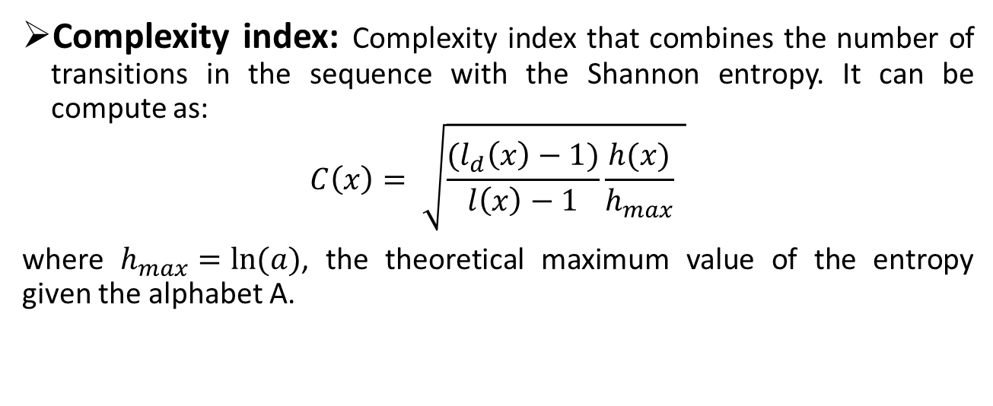
Describing the sequences: indicators
A
A
A
A
B
B
C
A
C
A
A
A
Sequence x
A
A
A
A
A
A
B
B
B
B
B
B
Sequence y
Complexity index: Complexity index that combines the number of transitions in the sequence with the Shannon entropy. It can be compute as:
$$C\left(x\right)= \sqrt{\frac{(l_{d}\left(x\right)−1)}{l\left(x\right)−1}\frac{h(x)}{h_{max}} }$$
where $h_{max}=ln⁡(a)$, the theoretical maximum value of the entropy given the alphabet A.
25

Slide 26
Describing the sequences: overall statistics
A
A
A
A
B
B
C
A
C
A
A
A
Sequence x
A
A
A
A
A
A
B
B
B
B
B
B
Sequence y
Overall statistics computed on the overall set of sequences.
Mean time spent in each state: a first synthetic information, the mean number of times each state that is observed in a sequence. It characterizes the overall state distribution.
e.g. mean time in the state A : (8+6)/2= 7
mean time in the state B : (2+6)/2= 4
mean time in the state C : (2+0)/2= 1
26

Slide 27
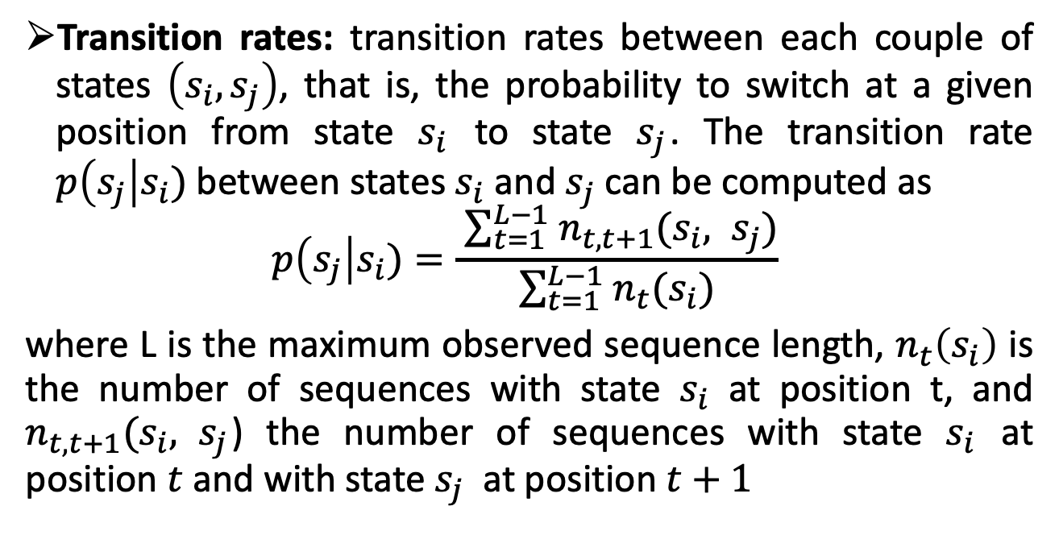
Describing the sequences: overall statistics
Transition rates: transition rates between each couple of states $\left(s_{i}, s_{j}\right)$, that is, the probability to switch at a given position from state $s_{i}$ to state $s_{j}$. The transition rate $p\left(s_{j}\right|s_{i})$between states $s_{i}$ and $s_{j}$can be computed as
$$p\left(s_{j}\right|s_{i})=\frac{ \sum_{t=1 }^{L−1}{n_{t,t+1}(s_{i}, s_{j})}}{\sum_{t=1 }^{L−1}{n_{t}(s_{i})}}$$
where L is the maximum observed sequence length, $n_{t}\left(s_{i}\right)$ is the number of sequences with state $s_{i}$ at position t, and $n_{t,t+1}(s_{i}, s_{j}$) the number of sequences with state $s_{i}$ at position $t$ and with state $s_{j}$ at position $t+1$
27

Slide 28
Dissimilarity-based analysis: cluster analysis
Central in sequence analysis since the first developments. Abbott and Tsay (2000) describe Sequence Analysis essentially as a three-step process:
(i) Coding individual observations as sequences of states
(ii) Measuring pairwise dissimilarities between sequences (using Optimal Matching)
(iii) Clustering the sequences from pairwise dissimilarities to find typical patterns (e.g. typical patterns of revolutions, typical patterns of musician career in Baroque Germany)
28

Slide 29
Measuring pairwise dissimilarities
A
A
A
A
B
B
C
A
C
A
A
A
Sequence 1
A
A
A
A
B
B
B
B
B
B
B
B
Sequence 2
A
A
A
A
B
B
B
B
B
B
C
C
Sequence 3
A
A
C
C
A
A
B
B
C
B
B
B
Sequence 4
A
A
A
A
A
A
C
C
C
C
C
C
Sequence 5
A
A
A
B
B
B
C
C
C
C
C
C
Sequence 6
29

Slide 30
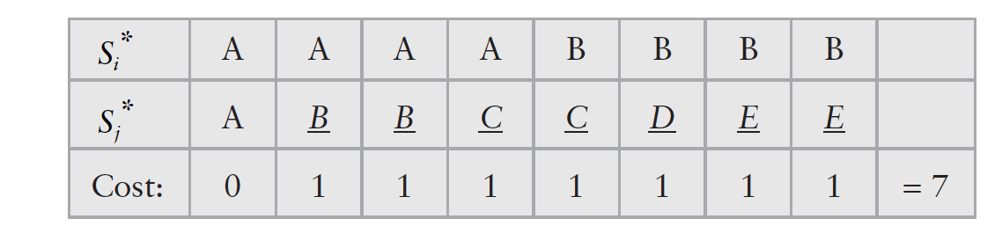
Measuring pairwise dissimilarities
Optimal Matching:
An algorithm to compute the distance between two sequences as the minimal “effort” of transforming one sequence into the other. To do so, we have to assign a penalty, a “cost”, for each operation or transformation we need to employ. The sum of these costs provide a measure of distance between sequences.
In classical Optimal Matching, the possible operations are element deletion, insertion, and substitution. We should then define the cost associated to each of these operations – let’s take an example by setting deletion, insertion, and substitution cost all equal 1.
30

Slide 31
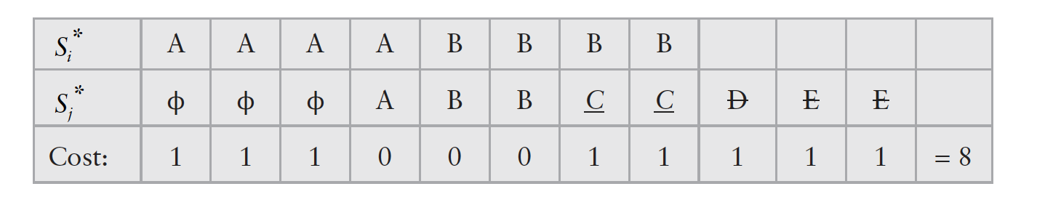
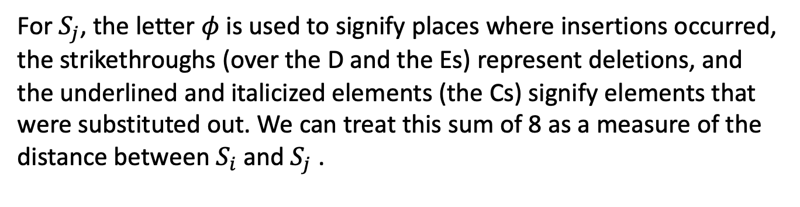
Measuring pairwise dissimilarities
Optimal Matching:
For $S_{j}$, the letter $φ$ is used to signify places where insertions occurred, the strikethroughs (over the D and the Es) represent deletions, and the underlined and italicized elements (the Cs) signify elements that were substituted out. We can treat this sum of 8 as a measure of the distance between $S_{i}$and $S_{j}$ .
31

Slide 32
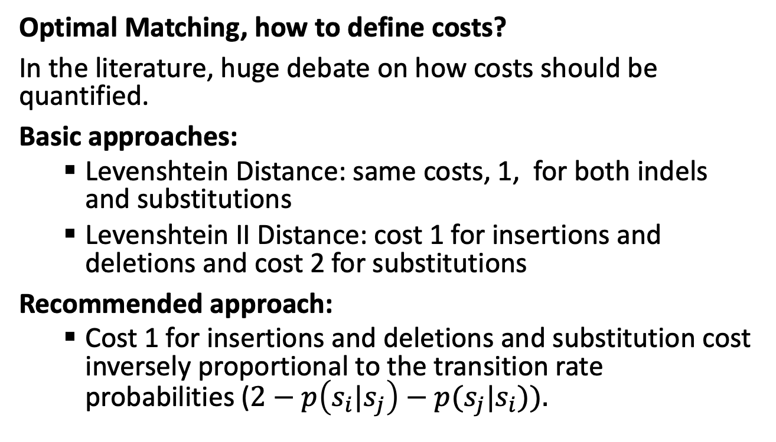
Measuring pairwise dissimilarities
Optimal Matching, how to define costs?
In the literature, huge debate on how costs should be quantified.
Basic approaches:
Levenshtein Distance: same costs, 1, for both indels and substitutions
Levenshtein II Distance: cost 1 for insertions and deletions and cost 2 for substitutions
Recommended approach:
Cost 1 for insertions and deletions and substitution cost inversely proportional to the transition rate probabilities ($2−p\left(s_{i}|s_{j}\right)−p(s_{j}|s_{i})).$
32

Slide 33
Cluster analysis
After defining a cost metric, it is possible to compute the dissimilarity matrix D, which contains the distances between subjects’ sequences (several algorithms available to run Optimal Matching).
Then, we can use the dissimilarity matrix in a clustering algorithm to compute groups of similar sequences, sets of cases that are less distant from (more similar to) each other. The assumption is that these different groups in turn reflect distinct classes of sequences.
Again, there is no consensus and numerous approaches are available. However, agglomerative hierarchical clustering approaches become widely used in the Sequence Analysis community.
33

Slide 34
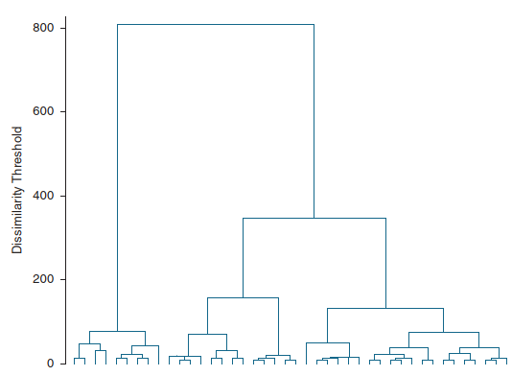
Cluster analysis
Agglomerative hierarchical clustering:
Initially consider all cases are singular clusters
Iteratively combine groups that are “close” to each other to some specified criteria until we eventually end up at a single large cluster.
Regardless of which linkage criteria are used, hierarchical clustering leads to a set of nested clusters that can be represented in a tree diagram, a dendrogram.
34

Slide 35
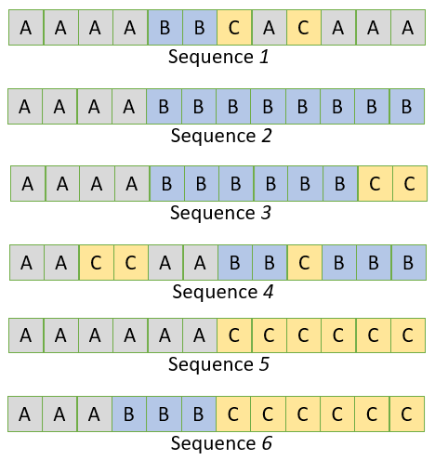
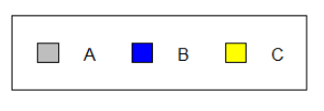
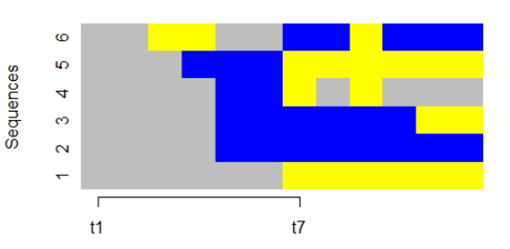
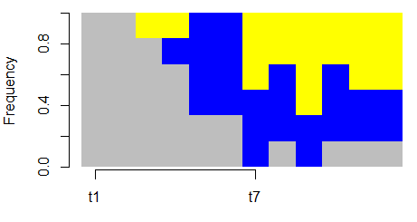
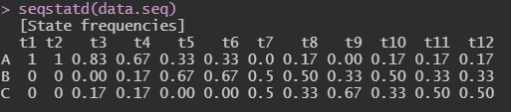
Sequence Analysis: data visualization
Alphabet legend
Index plot
State distribution plot
35

Slide 36
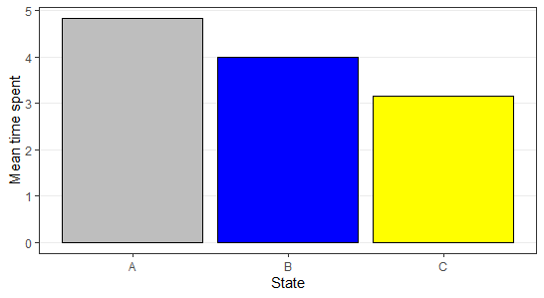
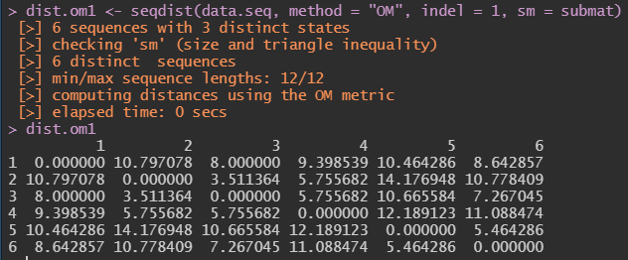
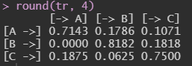
Sequence Analysis: data visualization
Mean time spent in ache state
Optimal Matching distance
Transition rate matrix
36

Slide 37
LAB SESSION
37

Slide 38
Lab Session 1
An easy toy example using our set of 6 sequences
38

Slide 39
Lab Session 2. Stratified pathways to Italy’s “Latest-Late” Transition to Adulthood
During the last decades, society as a whole has undergone substantial social, economic, and demographic changes.
The transition to adulthood progressively moved from an early, contracted, and simple pattern - dominant in the 1950s and 1960s - to a late, protracted, and complex pattern - dominant in contemporary developed countries.
Modernization -> Individualization and de-standardization of life course trajectories.
The Second Demographic Transition, a global and “individual choice” paradigm
Growing perspectives: centrality of social stratification, the gender revolution, and contextual opportunities and constraints.
39

Slide 40
The context: Italy in a comparative perspective
 |  | Italy | Northern Europe | Baltic States | Western Europe | Eastern Europe |  |  |  |  | Southern Europe
Entering the job market (Age 22)
Men |  | 59.0% | 77.8% | 89.2% | 74.5% | 71.3% |  |  |  |  | 69.8%
Women |  | 41.6% | 72.8% | 72.4% | 70.8% | 61.2% |  |  |  |  | 57.6%
Leaving the parental home (Age 22)
Men |  | 29.8% | 86.6% | 74.0% | 61.3% | 37.0% |  |  |  |  | 37.8%
Women |  | 28.9% | 90.9% | 84.1% | 77.2% | 47.6% |  |  |  |  | 50.9%
Living with a partner of a spouse (Age 30)
Men | 54.0% |  | 82.9% | 81.5% | 83.0% |  |  |  |  | 71.0% | 65.5%
Women | 57.3% |  | 89.6% | 91.6% | 89.9% |  | 81.7% |  |  |  | 78.5%
Parenthood (Age 30)
Men | 19.8% |  | 37.3% | 56.2% | 37.1% |  |  | 49.9% |  |  | 24.4%
Women | 34.3% |  | 56.2% | 73.8% | 59.7% |  |  |  | 66.2% |  | 44.1%
Italy, a unicum in the European panorama?
The “latest-late” transition to adulthood associated to the “lowest-low” fertility rates.
Note: Cohort of respondents born between 1978 and 1988. Northern Europe: Denmark, Finland, Norway, Sweden, Iceland. Baltic States: Estonia, Lithuania, Latvia. Western Europe: Austria, Belgium, United Kingdom, France, Germany, Ireland, The Netherlands, Switzerland. Southern Europe: Portugal, Spain.
Source: Authors’ elaborations of the European Social Survey Round 9, 2018. Post-stratification weights have been applied for between-countries analyses.
40

Slide 41
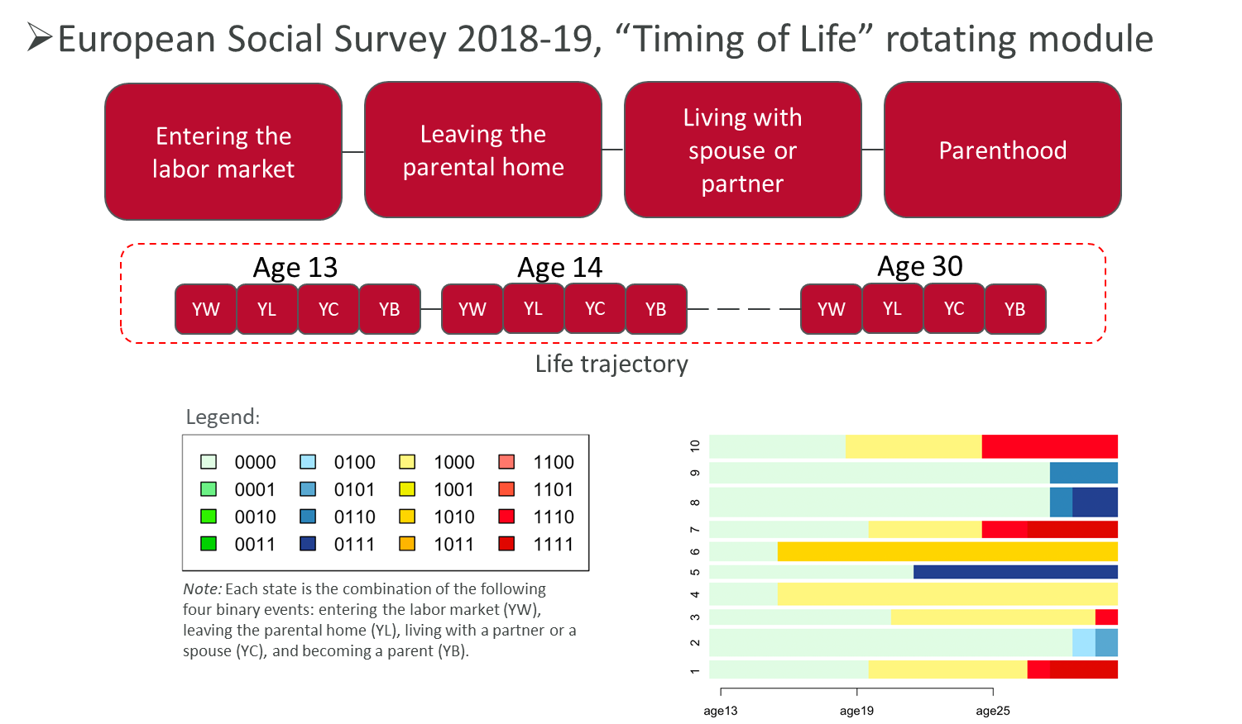
Data and methods
41

Slide 42
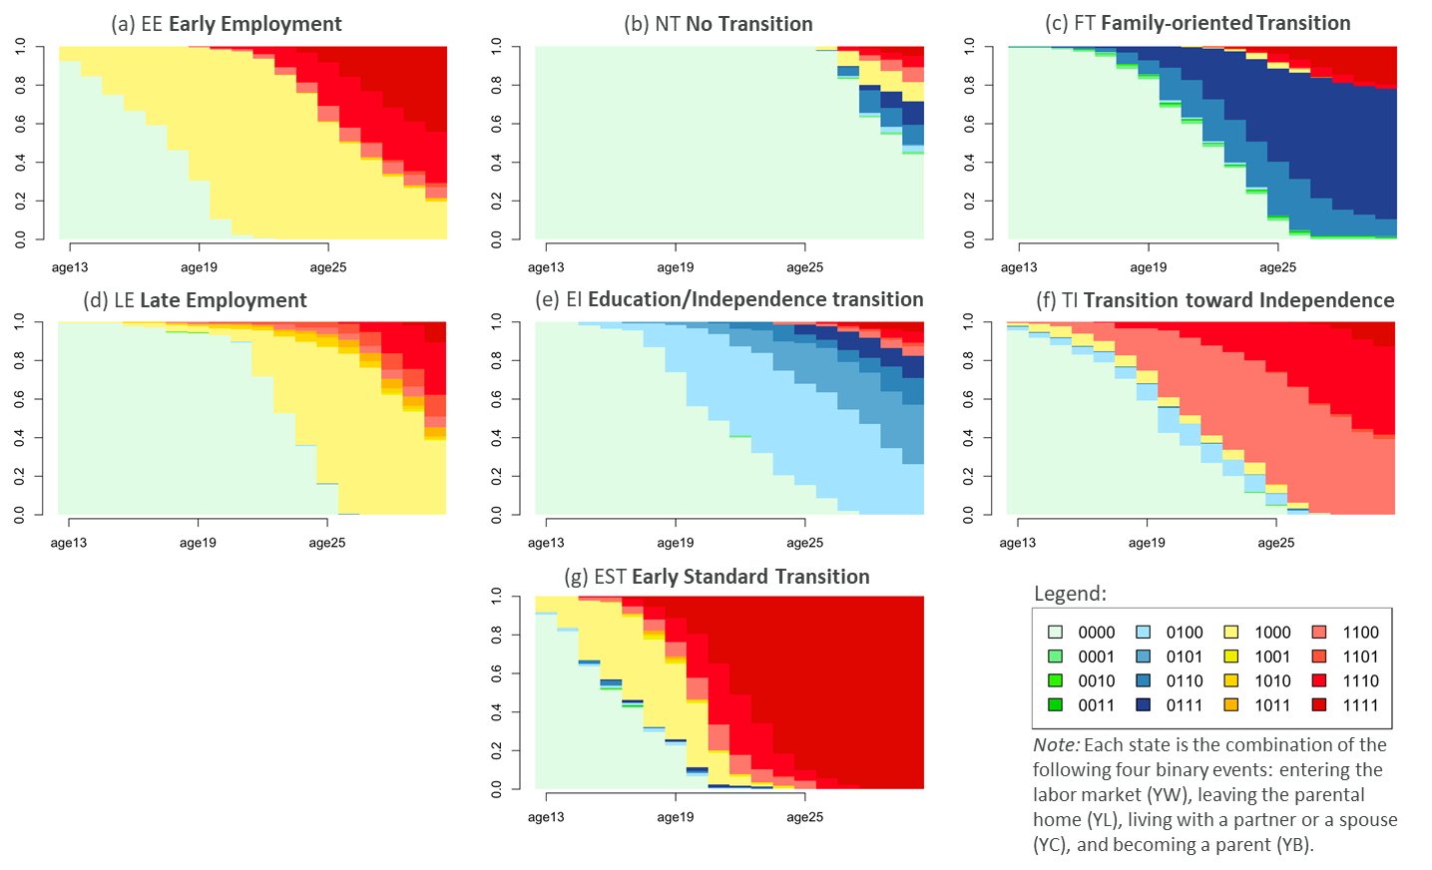
Sequence Analysis
42

Slide 43
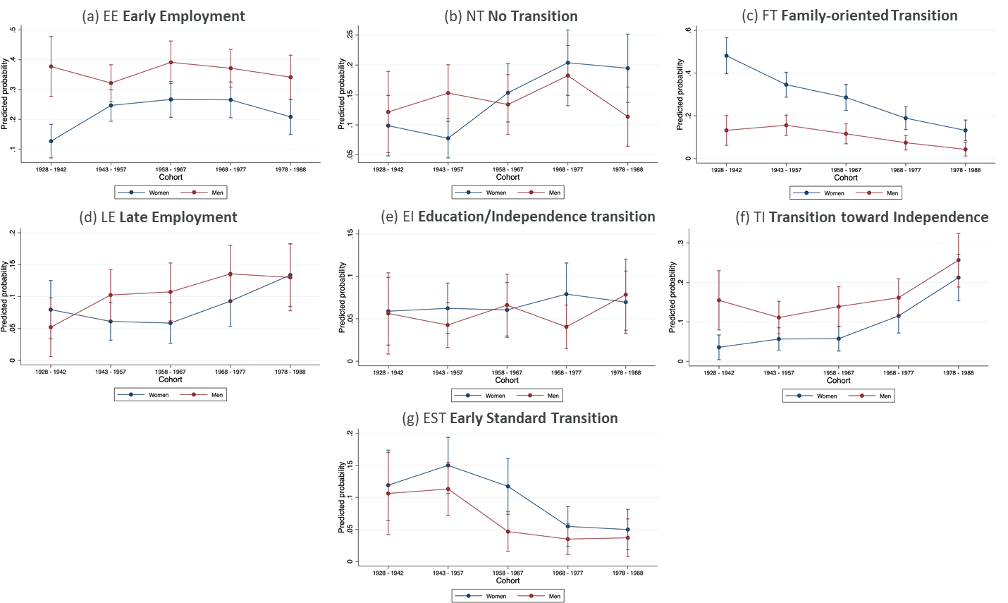
Multinomial logistic regression Predicted probabilities by gender and cohort
43

Slide 44
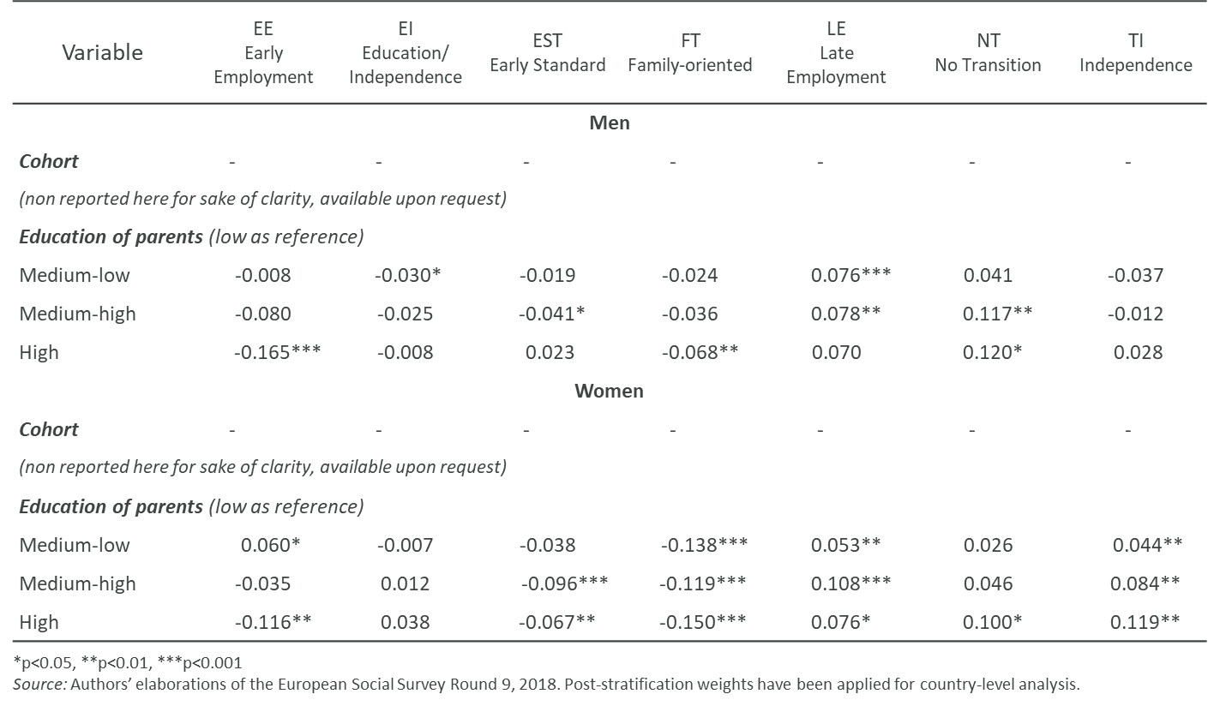
Multinomial logistic regression Average marginal effects by gender, cohort, and education of parents
44

Slide 45
R Code
45

